Slide 1
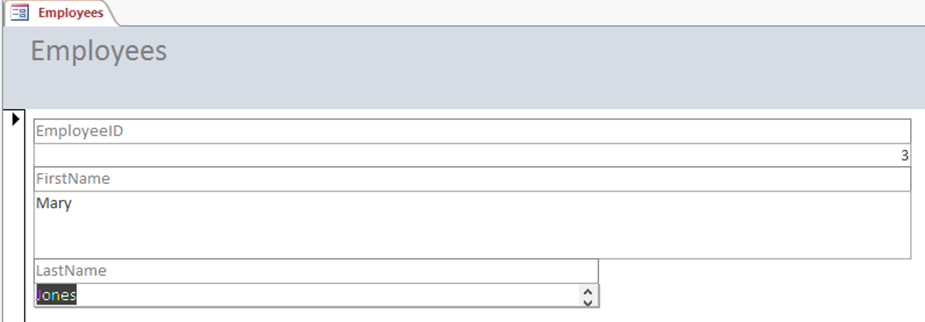
OCR Level 02 – Cambridge Technical
Unit 05 – Creating business solutions
2016 Specification - L/615/1355
LO4 - Be Able to Use IT Applications to Meet the Business Needs

Slide 2
Assessment Criteria
The Learner will | Pass The assessment criteria are the pass requirements for this unit. The learner can: | Merit To achieve a merit the evidence must show that, in addition to the pass criteria, the learner is able to: | Distinction To achieve a distinction the evidence must show that, in addition to the pass and merit criteria, the learner is able to:
1. Understand the role of the digital Business Practitioner | P1: Describe how the digital business practitioner supports business.
2. Be able to design solutions to meet business needs | P2: Design a solution to meet the identified business need. |  | D1: Justify how the design proposal supports the business needs.
3. Be able to present business solutions to stakeholders | P3: Create a prototype of the proposed business solution. | M1: Modify the design in response to stakeholder feedback.
 | P4: Present the prototype to identified stakeholders.
4. Be able to use IT applications to meet business needs. | P5: Create the proposed business solution. | M2: Test the solution to confirm functionality. | D2: Assess the appropriateness of the solution to the business need.
 | P6: Gather feedback from stakeholders of the proposed solution.

Slide 3
Assessment Criterion P5, M2, P2, D2
P5 - The learner must create the proposed business solution. The evidence would be the actual created solution which may be paper-based or electronic.
M2 - The learner is required to test the solution to confirm functionality. It is therefore expected that the learner would create a test plan which provides the following information: test number, what is being tested, expected results, actual results, errors that arise, steps taken to resolve errors and retest no. It is important that the tests are meaningful and result in the testing of the functionality of the proposed solution. This has nothing to do with spell checking, etc.
Ideally, the test should be conducted with the learner using data made available by the ‘business’ from the scenario.
P6 - The learner is required to gather feedback from the stakeholders of the proposed solution (this is the stakeholder’s second review of the proposed solution after the agreed changes have been made). The feedback could take the form of questionnaires completed by the stakeholder(s), a video or audio recording of the stakeholder(s) providing the feedback.
D2 - The learner is required to assess the appropriateness of the solution to the business need. The assessment will require the learner to offer a reasoned judgement of the standard/quality of situation/skills informed by relevant facts. They should refer back to the original business requirements to consider how the solution meets the need of the identified business. The evidence could take the form of a report, a presentation with detailed speaker notes or an audio/visual presentation.

Slide 4
LO4 - Assessment Criterion
4.1 - Create solution based on agreed design
4.2. - Test the solution, i.e.:
actual results compared to expected results of implementing the solution
4.3 - Gather feedback from stakeholders.
4.4 - Review the effectiveness of the solution. i.e.
analyse feedback from stakeholders
review against stakeholder needs
consider future improvements/ enhancements/ developments
Why do teachers do registers each lesson What happens if my attendance drops below 95%. Who will know? What Management System does my school have Can I see my own grades How much data is automated and how much needs to be typed.

Slide 5
Unit 05 - Scenario
IT applications are commonly found in businesses. Digital practitioners play an important role in supporting businesses. You will design and create a business solution in conjunction with a stakeholder.
Progress Solutions for Business
Progress Solutions for Business is an existing organisation that offers administration services for businesses and organisations, as well as creating business solutions. The staff consists of:
• a manager who has overall control of the organisation and also markets Progress Solutions for Business to external clients;
• a supervisor who oversees the work of the administrative staff;
• six administrative staff who provide the administration services.
It provides the following services:
• word processing of reports and letters;
• production of leaflets and brochures with graphical images;
• creation of presentations which could include graphical images, video and audio clips and animations;
• spreadsheet solutions;
• database solutions;
• website creations;
• social media consultancy;
• business IT applications.
A client, Westwood Recruitment Services (WRS), is an employment agency which specialises in providing staff for the hospitality industry. The agency has vetted the CVs supplied to them by applicants to match these with a potential job role e.g. chef. When an employer has a vacancy for a job such as a chef, WRS will let applicants know about the job role and find out if they wish to be interviewed for the position. WRS will set a closing date, and after the closing date it will arrange interviews for all the applicants interested in the post, sending them a letter inviting them for interview. The letter will inform the applicant about the location, date and time of the interview, as well as any other key details that may be relevant.
Why do teachers do registers each lesson What happens if my attendance drops below 95%. Who will know? What Management System does my school have Can I see my own grades How much data is automated and how much needs to be typed.

Slide 6
LO4 – Learning Outcome
Learning Outcome 4: Be able to use IT applications to meet business needs.
Your task is to: create the solution for Westwood Recruitment Services (WRS). This will be the updated version based on the feedback you obtained in Task 3. You will then test the solution to make sure that it works properly. You will get feedback about the solution you have produced from the representative for WRS (this might be your tutor) and then assess how appropriate the solution is that you have created, in terms of meeting the business needs of WRS.

Slide 7
LO4 – Learning Outcome
Pass | Merit | Distinction
P5: Create the proposed business solution | M2: Test the solution to confirm functionality | D1: Justify how the design proposal supports the business needs
P6: Gather feedback from stakeholders of the proposed solution |  | D2: Assess the appropriateness of the solution to the business need
Evidence
The actual electronic created solution. This must include: the data used i.e. stored in the solution; examples of output from the solution. Testing the solution. This should include a test plan: what is being tested; the expected result of each test; the actual result of each test; steps taken to resolve any errors; evidence of retesting where errors had occurred. The test plan must test the functionality of the solution. Feedback in the form of questionnaires completed by the stakeholder(s), or a video or audio recording of the stakeholder(s) providing the feedback. Feedback provided by the stakeholder of the proposed solution (i.e. the second review after the agreed changes (in Task 3) were made)). A report or a presentation with detailed speaker notes or an audio/visual presentation. This must include: a judgement of the quality of the solution; a review of the original requirements to consider how the solution you have created meets the business needs of WRS.

Slide 8
P5.1 – Create the Proposed Solution
For P5 you need to create the solution to the scenario in as best a possible way as you can. It does not need to work perfectly but does need to achieve the basic components of the scenario which are:
The agency has vetted the CVs supplied to them by applicants to match these with a potential job role e.g. chef.
When an employer has a vacancy for a job such as a chef, WRS will let applicants know about the job role and find out if they wish to be interviewed for the position.
WRS will set a closing date
And after the closing date it will arrange interviews for all the applicants interested in the post, sending them a letter inviting them for interview.
The letter will inform the applicant about the location, date and time of the interview, as well as any other key details that may be relevant.
P5.1. Task 01 - Create solution based on agreed design.
By now you should have already decided on the manner of the solution, (web page, access file, spreadsheet). Personally for this I would use Access and forms for the letter or I would use Excel with an input box and VLOOKUP and Word Mail Merge for the letter. Either way the data for about 10 employees and employers needs to be input to make this effective.
You will be expected to present this solution to the client and expect feedback with things that could be improved, so as long as it almost works this will be OK>

Slide 9
M2.1 – Test the Solution
For M2 you need to run a series of functionality tests that demonstrates that the solution works and allows you to improve the creation and working method of the solution.
These tests need to be evidenced to demonstrate to the client that the solution has bene thought about. Use the template below to test iteratively (during production) and summative (after completion).
You should test at least 5 things during creation and 5 things after, evidence needs to show before and after testing. Any repairs should also be cataloged as proof that you have considered the solution.
It is important that the tests are meaningful and result in the testing of the functionality of the proposed solution. This has nothing to do with spell checking, etc.
M2.1 – Task 02 - Test the solution to confirm functionality
Test Number | What is being tested | Expected results | Actual results | Errors that arise | Proposed solution | Evidence
1 | That the form box allows me to choose from a list of employers | A drop down list should appear of all employers | All employers appeared | Two of the new clients are missing from the list | Change the range of the clients named cells to include them. | See screen 1 and 2 below.

Slide 10
P6.1 – Stakeholder Solution Feedback
For P6 you need to gather feedback from the stakeholders of the proposed solution (this is the stakeholder’s second review of the proposed solution after the agreed changes have been made).
The feedback could take the form of questionnaires completed by the stakeholder(s), a video or audio recording of the stakeholder(s) providing the feedback.
Questions asked in this feedback need to be more up to date on the completes solution than the prototype so they need to include questions on meeting their needs, ease of use, quality of printed letters, accessibility, and a range of suggested improvements and enhancements to make it more usable for their staff.
There should be at least 4 questions that are qualitative (questions on how or why with expected feedback).
P6.1 - Task 03 – Create a questionnaire or arrange feedback from the client on the proposed solution and gather this feedback.

Slide 11
P6.1 – Stakeholder Solution Feedback
For D2 you need to produce an in depth review of the feedback from the client and the effectiveness of the solution in your own opinion with the objective of future proofing the solution.
D2.1 – Task 04 – Create a report that reviews the effectiveness of the solution in line with the client needs and future considerations.
For this report you will need three sections:
Analyse feedback from stakeholders – Using the questionnaire feedback, take each of the completed questions and review the answer. If you gave out three questionnaires, average the answers in your write up. There should have been about 10 questions so there should be 10 parts to this feedback review.
Review against stakeholder needs – In the sections about meeting their needs, write a review of whether it has been met, how it was met, and whether you think the client was satisfied with the solution. What were the best bits, what worked well.
Consider future improvements / enhancements / developments – you will need to make a range (at least 3 fully explained) suggestions on how the solution could be improved, now or in the future, these could include training options, manuals, in product help, making it web based, locking it down, using Macros, automating some of the processes etc.

Slide 12
LO4 – Assessment Criteria
P5.1. Task 01 - Create solution based on agreed design.
M2.1 – Task 02 - Test the solution to confirm functionality
P6.1 - Task 03 – Create a questionnaire or arrange feedback from the client on the proposed solution and gather this feedback.
D2.1 – Task 04 – Create a report that reviews the effectiveness of the solution in line with the client needs and future considerations.

